Slide 1
GRAPHS AND NETWORKS PROJECT
Main Research Paper:
Using graph theory for automated electric circuit solving by L Toscano, S Stella, and E Milotti
Publication: European Journal of Physics, Vol.36., Issue 3
Year:March 2015
Reference Research Papers:
R1: Application of Graph Theory in Electrical Network By Berdewad O. K., Dr. Deo S. D.
R2: Algorithms for Finding a Fundamental Set of Cycles for an Undirected Linear Graph By C. C. Gotlieb and D. G. Corneil

Slide 2
Reference-1
Application of Graph theory in Electrical network
Reference Research Paper 1:
Application of Graph Theory in Electrical Network By Berdewad O. K., Dr. Deo S. D.
Publication: International Journal of Science and Research , Vol.5, Issue 3
Year: March 2016

Slide 3
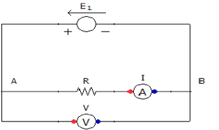
Ohm’s Ω Law
Relation between current flowing b/w nodes and potential around them
where R is resistance
where C is conductance

Slide 4
Ohm’s law on circuit graph
Let us assume that current flowing through edge e is ie
Then ie = ve / re where ve is potential across edge
Also ie = ve . Ce
i{uv} = -i{vu}
r{uv}=r{vu}, c{uv}=c{vu}

Slide 5
Kirchhoff’s circuit law
Kirchhoff’s voltage law states that for closed loop total voltage of all components is zero.
Kirchhoff’s current law states that at a given node total entering current and total leaving current are equal.

Slide 6
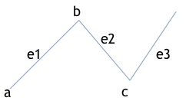
Basics of Graphs
G = (V,E)
V is set of vertices and E is set of edges
e is an edge denoted as e=(v1,v2)
V={a,b,c,d}
E={(a,b),(b,c),(c,d)}
d

Slide 7
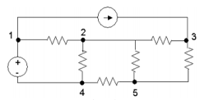
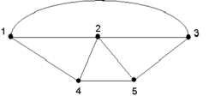
Representation of circuit and its graph
A graph model is used to represented circuit network in graph by tracing the nodes of the circuit and edges contain in circuit.

Slide 8
Matrix representation of graph
We have two types of representations
1. Adjacency matrix
row and column represent vertices
2. Incidence matrix
row represents vertices
column represents edges

Slide 9
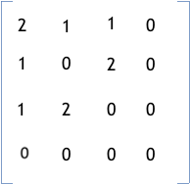
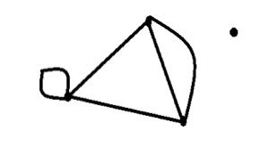
Adjacency matrix

Slide 10
We have divided our work on the first paper into 4 parts:-
Circuit Description
Construction of the spanning tree
Finding Independent Loops
Loop orientation

Slide 11
Circuit description
We describe an electric circuit with n nodes with three n × n matrices: the adjacency matrix A = {aij}, the resistors’ matrix R = {rij} and the voltage sources’ matrix V = {vij}. As usual, in the adjacency matrix the element aij = 1 when nodes i and j are connected, while aij = 0 when the nodes are not connected. Likewise in the resistors’ matrix the element rij is equal to the resistance of the branch that links nodes i and j, and in the voltages’ matrix the element vij is equal to the voltage of a voltage source in the branch that links nodes i and j. The sign convention for the voltage is that the matrix element vij is positive if node i has a lower potential than node j. The total number of nodes, as well as the three matrices are stored on file and are read by the program during the initialisation step.

Slide 12
Circuit description
In the code we first read the content of the csv file using a while loop. We first find the dimension of the matrix inside the while loop and store it in a variable named ‘pos’. Then using this we read in the adjacency matrix, the resistance matrix and the voltage matrix.
Once we have this information we use the adjacency matrix to have the graphical representation of the circuit with the nodes marked according to the nodes given in the csv file. We perform this operation of drawing the graph using a library of python called networkx.

Slide 13
Spanning tree
A subtree T of graph G is called a spanning tree if V(T) = V(G).
A subgraph which covers all the vertices while using minimum possible number of edges
The paper follows the hint from the paper of Gotlieb and Corneil i.e., the algorithm works by constructing a spanning tree first, and then it yields a fundamental set of cycles by adding the discarded branches, one at a time, to the spanning tree.

Slide 14
Reference- 2
Algorithms for Finding a
Fundamental Set of Cycles for
an Undirected Linear Graph
Reference Research Paper 2:
Algorithms for Finding a Fundamental Set of Cycles for an Undirected Linear Graph By C. C. Gotlieb and D. G. Corneil
Publication: Communications of the ACM , Vol.10
Year: September 1969

Slide 15
Step 1
Graph is represented by its adjacency matrix A
The set of n nodes is partitioned with respect to some chosen edges to form a set of disjoint trees with adjacency matrix B.
For each row i of A, bij = bji = 1 if aij is the first superdiagonal element of the ith row of A equal to 1; otherwise set bij = bji = 0.

Slide 16
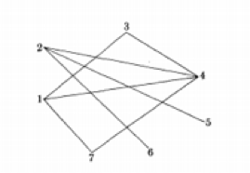
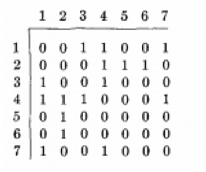
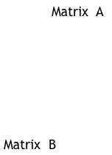
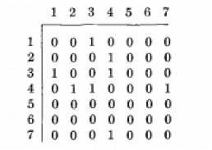
Example
Graph

Slide 17
Step 2
In this step the n nodes of the given graph are divided into connected components with respect to edges chosen in step 1
Let x be a vector of length n initially set at zero
Set x(j) = 1 if node j belongs to one of these connected components; otherwise, set x(j) = 0.
The connected components are denoted by the matrix C; cij = 1 if node j belongs to the ith connected component, and 0 otherwise.

Slide 18
Suppose x(j) = 1 for all j < k.
We now determine the connected component to which node k belongs. This (i + 1)st component is the set of nodes that are descendants of k.
Update vector x, find the next component, and continue this process until every element of x = 1

Slide 19
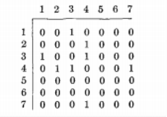
Example
Initially X=(0,0,0,0,0,0,0)
n nodes are divided into connected components w.r.t matrix B.
thus connected component to
which node 1 belongs is
determined by 1,2,3,4,7
X=(1,1,1,1,0,0,1)

Slide 20
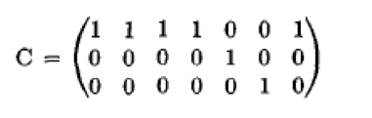
The next component is alone of node 5
Thus X=(1,1,1,1,1,0,1)
Similarly node 6 is also isolated and thus connected in itself
X=(1,1,1,1,1,1,1)
Thus C denotes connected components

Slide 21
Step 3
Here the connected components are amalgamated by adding appropriate edges to the adjacency matrix B.
This is achieved by repeatedly examining the component with the smallest number of nodes.
There must exist a edge which joins one of the nodes of this component to some node in another component.
Choose one such edge and add to matrix B
After this step B is adjacency matrix of spanning tree

Slide 22

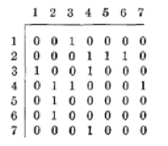
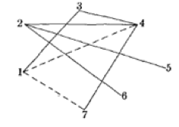
Example
(2,5) and (2,6) are added to the original graph
Intial B
Final B
Spanning tree

Slide 23
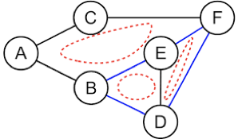
Fundamental Cycles
The cycles of a fundamental set are such that:
a) their union contains all the cycles of the original graph
b) they are independent, in the sense that any given cycle in the set is not contained in any union of the remaining cycles.
In figure I, the cycles which form the set of fundamental cycles are:
ACFEB
DEF
BDE
In order to set up a system of independent equations for the currents, we need a fundamental set of cycle, i.e., a set of independent current loops.

Slide 24
Step 4
Each edge of original graph when added to spanning tree form a fundamental cycle.
In this step all such cycles are generated

Slide 25
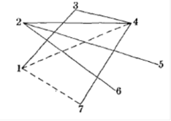
Example
Adding (1,4) gives cycle 134
Adding (1,7) gives cycle 1347

Slide 26
Construction of a spanning tree
We implement a vertex-centric algorithm to find a spanning tree as it is more efficient and constructs spanning tree in a more structured way. The pseudocode is shown and A and B adjacency matrices of the original graph and the resulting spanning tree respectively.

Slide 27
Construction of a spanning tree
C is a matrix where we keep record of the vertices already included in the process of constructing spanning tree.
A & B are the matrices of size N x N
The Algorithm: -
Initialize the first vertex in C i.e. C₀ = 1
For i, from 1 to N-1
C_{i} = 0
For i & j, from 0 to N-1
B_{ij} = 0

Slide 28
for i, j from 0 to N - 1
if A_{ij} = 1 and C_{i} = 1 and C_{j} = 0
B_{ij} = 1
B_{ji} = 1
C_{j} =1
if A_{ij} = 1 and C_{i} = 0 and C_{j} = 1
B_{ij} = 1
B_{ji} = 1
C_{i} = 1

Slide 29
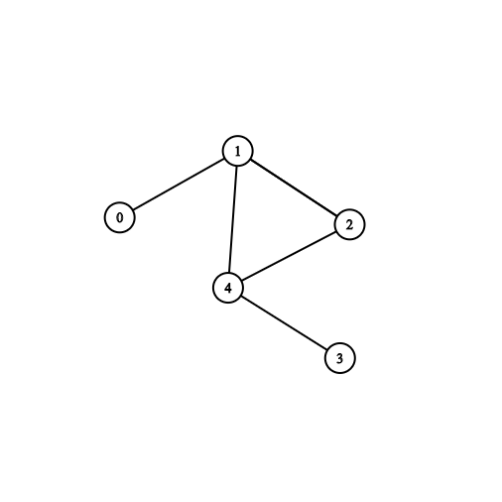
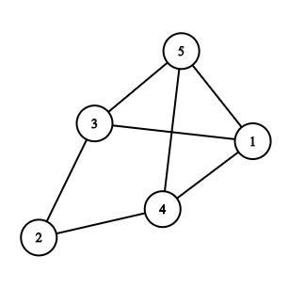
Example
0 1 0 0 0
1 0 1 0 1
0 1 0 0 1
0 0 0 0 1
0 1 1 1 0
0 0 0 0 0
0 0 0 0 0
0 0 0 0 0
0 0 0 0 0
0 0 0 0 0
A = B =
C =
1
0
0
0
0

Slide 30
Step: - 1
As for C₀ = 1 , A₀₁ = 1 and C₁ = 0
Hence we add edge (0,1) to the spanning tree and set C₁ = 1
0 1 0 0 0
0 0 0 0 0
0 0 0 0 0
0 0 0 0 0
0 0 0 0 0
1
1
0
0
0
B=
C =
Step:-2
Now, for A₁₀ = 1 we have C₀ =1 and C₁ = 1 hence we don’t add the edge again as it will then create a loop.
0 1 0 0 0
0 0 1 0 0
0 0 0 0 1
0 0 0 0 0
0 0 0 0 0
1
1
1
0
1
B=
C =
Step: - 3
Continuing similarly we get,

Slide 31
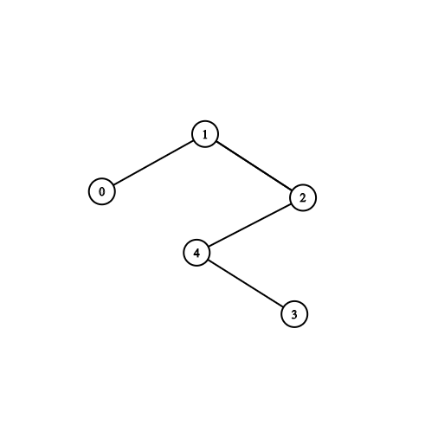
Now, we have A₄₃ = 1 & A₄₁ = 1
But for A₄₁ C₄ = 1 & C₁= 1, hence we won’t add edge (4,1) as vertex 1 is already present in the spanning tree and adding this edge will create a cycle
And for A₄₃ C₄ = 1 and C₃ = 0 , so we add edge (4,3) to the spanning tree.
As all the nodes in C matrix are now set to 1, it means that we have covered all the vertices and have our spanning tree ready.
1
1
1
1
1
0 1 0 0 0
1 0 1 0 0
0 1 0 0 1
0 0 0 0 1
0 0 1 1 0
B=
C =

Slide 32
Construction of Fundamental Cycles from Spanning Tree
To find set of independent loops/fundamental cycles of a graph, we first need its spanning tree.
Now we pick up the leaf nodes of the spanning tree and join it to one of the other vertices of the tree. This gives us a graph with a cycle in it.
Remove all the edges from the graph which are not the part of the cycle(Pruning). The obtained cycle will be an independent cycle.
We repeat this process until we find all the possible independent cycles.

Slide 33
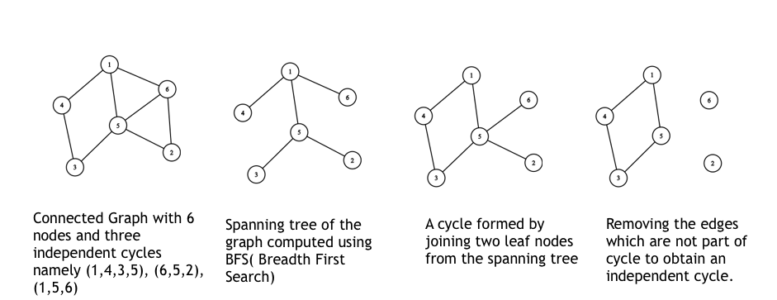
An example to illustrate construction of fundamental cycles from spanning tree

Slide 34
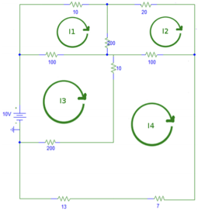
Loop Orientation
Once we are able to generate the fundamental cycles from the spanning tree by creating a cycle and pruning the tree, we set the orientation in the loops arbitrarily, representing the direction of flow of current in the individual cycles.
For every loop, we select a random edge, remove its opposite edge. This sets the loop’s orientation
Following this edge’s direction, we set the direction of the other links in the loop.

Slide 35

This continues till all the loops are oriented
After we have all the loops oriented, we combine them together to get the original circuit with the current directions of all the loops.
Now, we can set up a system of linear equations of the form,
The solution of the linear equations yields all the independent loop currents, using which we find the branch currents by summing over all the loop currents.

Slide 36
Drawbacks of the Algorithm mentioned in the Research Paper
We believe that the time complexity for solving the given set of algorithms is much higher and therefore, we have attempted to devise our own methodology to solve the problem statement by using a set of codes which are much easier and simpler to comprehend.
It was also noted that much of the research paper was primarily focused upon finding independent loops, which are not a necessity to find Kirchhoff's Voltage Equations. They can be found using any loop of the circuit, irrespective of the fact that it is fundamental or not.
We also observed that the code for finding independent loops in the research paper doesn’t always return fundamental cycles. For some graphs, we implemented the code and the cycles which came as an output were a combination of two or more fundamental loops.

Slide 37
The better approach...
After going through the research paper, we thought to come up with our solution for the problem statement that could be more effective to solve. Hence, we wrote a set of codes in Python, which can be divided as follows:
We take the adjacency matrix of the graph as an input and convert it into adjacency list so that we could input it in the code to find the set of all cycles.
Now, we pass the adjacency list of vertices into the code so that it could return the list of all possible cycles in the graph. (Algorithm explained in the next slide)
We know the number of fundamental cycles that exist in the graph and therefore, we choose that much cycles of smallest length( which is a trait of fundamental cycles.)
We now make the adjacency matrix from these chosen cycles and then we pass it onto the functions which finally assign the current to these loops with respective directions.
we multiply the matrix assigned with current to respective resistances and then sum them up to equate with the net voltage in the loop(if any). {Implementation of KVL}
At last, we get a set of equations that is solved using np.linalg.solve() to output the currents.

Slide 38
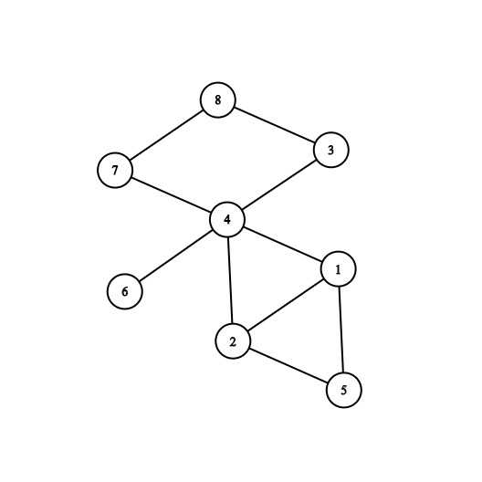
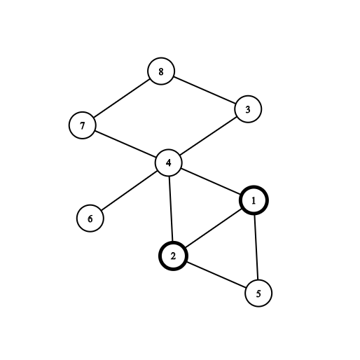
Logic behind finding set of all possible cycles
Graph_list_of_edges = [[1,2], [2,4], [4,1], [4,6], [2,5], [5,1], [4,3], [3,8], [8,7], [7,4]]
First edge is picked from the list of edges. The elements of each edge is subsequently set to node1,node2 on which further conditions are checked .
1st node is initialised to path[0] as well to start_node and then node1.
2nd node is set to next node and node2, for further iteration. It is stored in path[1].

Slide 39
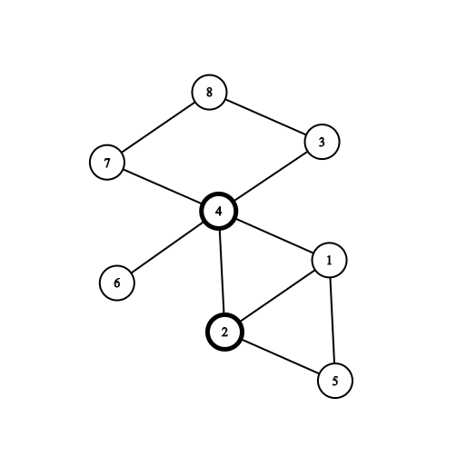
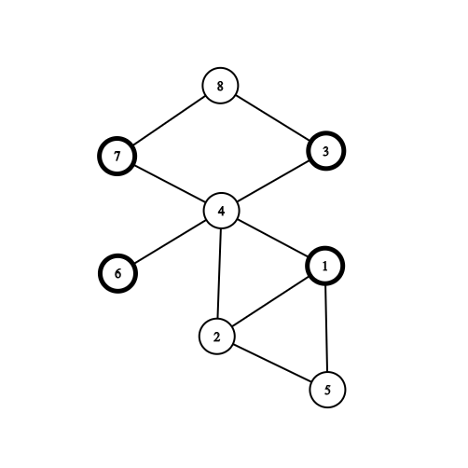
In the next iteration, next edge will be chosen from the graph such that node2 of previous edge is node1 of current edge. Now, we’ll store the vertices of this edge in node1,node2 and keep iterating the process while storing the each vertex in list ‘path’.
4 will be set to node2 in this iteration while also saving in path
It is possible that at some node, there maybe multiple paths to move.
We choose edge [2,4] since node2 was 2 in previous iteration.

Slide 40
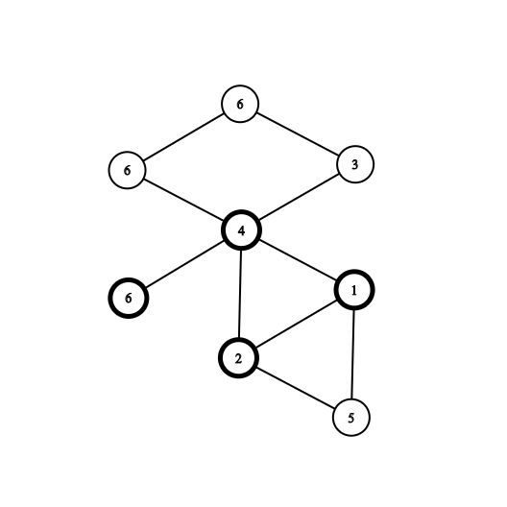
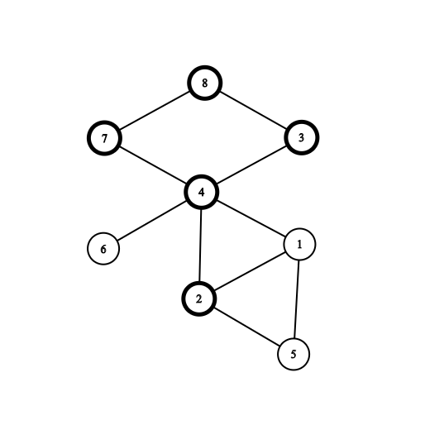
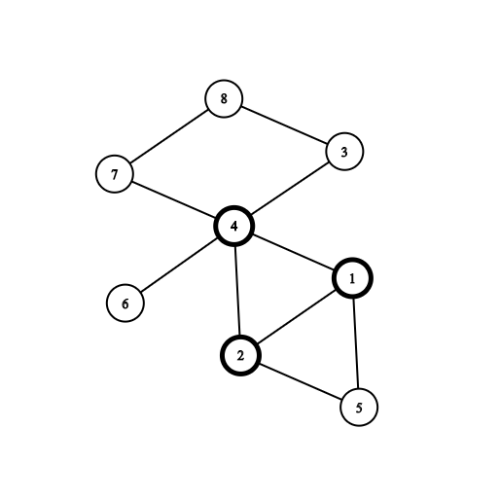
If there are multiple paths to move from a given node, then we traverse through each path and keep storing the vertices in ‘path’ list until in either reaches start_node, a leaf node or itself.
As soon as the vertex reaches a leaf node, it is not able to find a corr. Edge in the list and hence for this iteration, node2 = ‘null’ which signals to terminate the current path and return to previous node.
In this case, we happen to encounter a node again in our path on which we already travelled. Hence, we eliminate this by checking if node1 = path[i+1] for all i.
This happens to be our desired output. We confirm this is a cycle by checking if node2 = start_node. If the condition is satisfied, append path in cycles.

Slide 41
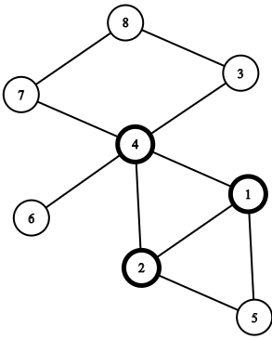
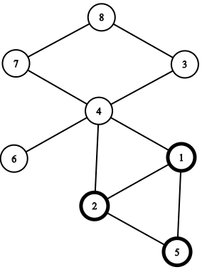
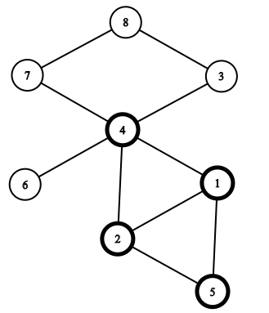
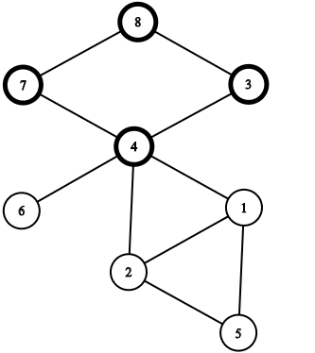
Shown below are the list of cycles that are formed from the algorithm:
Cycle 1: (1,2,4) Cycle 2: (1,2,5) Cycle 3: (1,5,2,4) Cycle 4: (4,3,7,8)
(Notice that Cycle 3 is combination of 1 and 2)

Slide 42
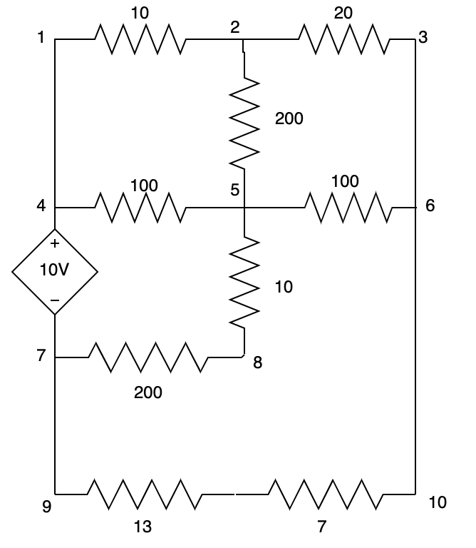
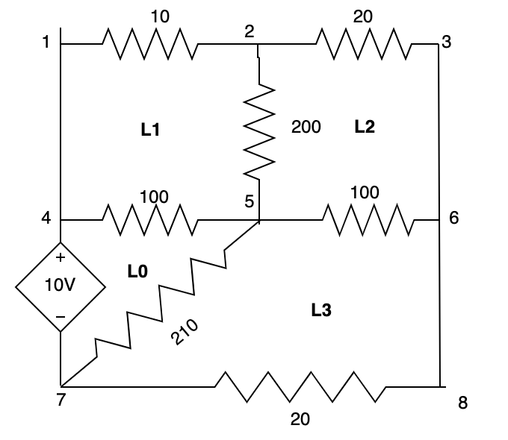
Forming KVL Equations From Adjacency Matrix of Fundamental Loops
Basics:
KVL(Kirchhoff's Voltage Law) : Kirchhoff’s voltage law states that for closed loop total voltage of all components is zero.
Equivalent Resistances:
Series : R_{Net}= 𝝨R_{i}
Parallel : R_{Net}= (1/𝝨R_{i})⁻¹
Assumptions:
Assuming Current In Clockwise Direction in all the loops.
Using a Simplified circuit by finding equivalent resistances.
Using the Smallest Independent Cycles
We first sort all the cycles according to their length
Then we choose the first (m - n + 1) cycles
Edges Vertices
Finding:
It was founded that if above assumptions were
Followed then we were able to eliminate the loop
Orientation step and directly find the KVL equations

Slide 43
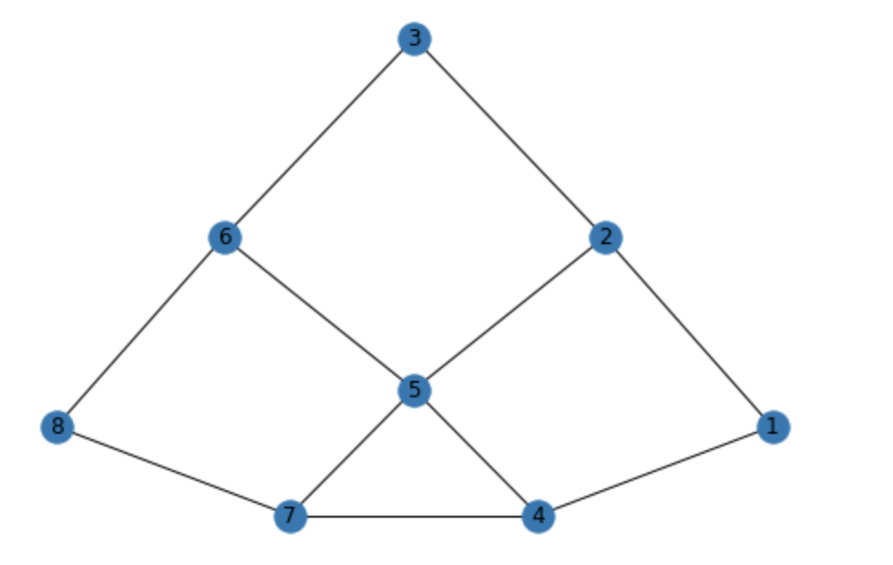

Forming KVL Equations From Adjacency Matrix of Fundamental Loops
Idea:
Since a branch can be common to at most two loops
Thus If we follow clockwise direction for applying KVL then for a branch we always get the equation:
𝝨[(Current across branch in container loop - Current across branch in common loop) * Resistance of branch] = Voltage across container Loop
For Eg:
Consider branch 5-7. Since 5-7 is common b/w Loop0 and Loop3 we get expression,
( I₀ - I₃) * R₅₋₇
Similarly, for branch 7-4 we get expression,
( I₀) * R₇₋₄
Similarly, for branch 4-5 we get expression,
( I₀ - I₁) * R₄₋₅
Thus for Loop Zero we have the equation,
(I₀ - I₃) * R₅₋₇ + ( I₀) * R₇₋₄+ ( I₀ - I₁) * R₄₋₅= 0
I2
I3
I1
I0

Slide 44
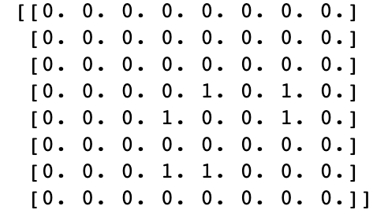
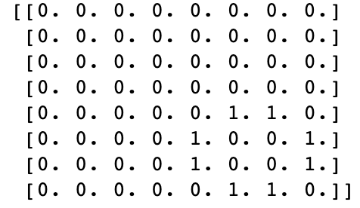
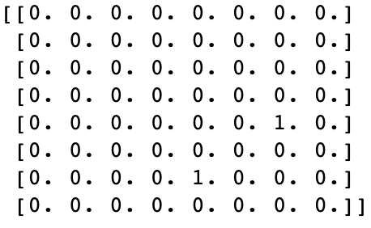
Forming KVL Equations From Adjacency Matrix of Fundamental Loops
Problem:
To somehow find the loops common to a branch!
Solution:
As through adjacency matrix we are able represent any electric circuit completely.
We use the adjacency matrix of the Independent Loops and take their element-wise multiplication to find the loops common to a branch.
For Eg:
Consider branch 5-7, we know it is common to Loop 0 and Loop 3, Since
L2
L3
L1
L0

Slide 45
Forming KVL Equations From Adjacency Matrix of Fundamental Loops
Code:
Function: “equations”
Adjacency Matrix of Independent Loops
Equations corresponding to different loops
Adjacency Matrix of Resistances

Slide 46
ABOUT SPICE
SPICE (Simulation Program with Integrated Circuit Emphasis) is a general-purpose, open-source analog electronic circuit simulator. It is a program used in integrated circuit and board-level design to check the integrity of circuit designs and to predict circuit behavior.

Slide 47
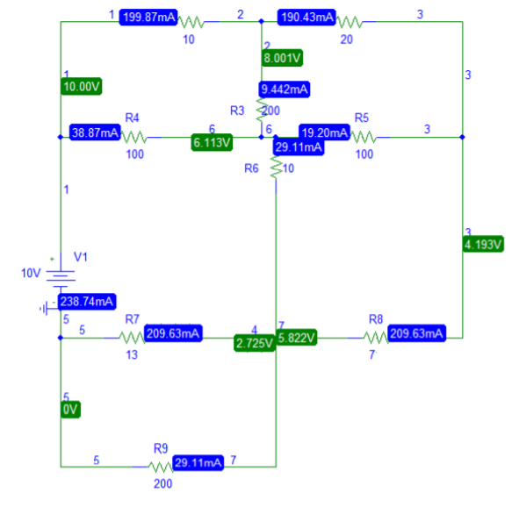
PSPICE: Output of the circuit
I1
I2
I0
I3

Slide 48


Program Output:
Loop equation obtained:
Loop Currents obtained:

Slide 49
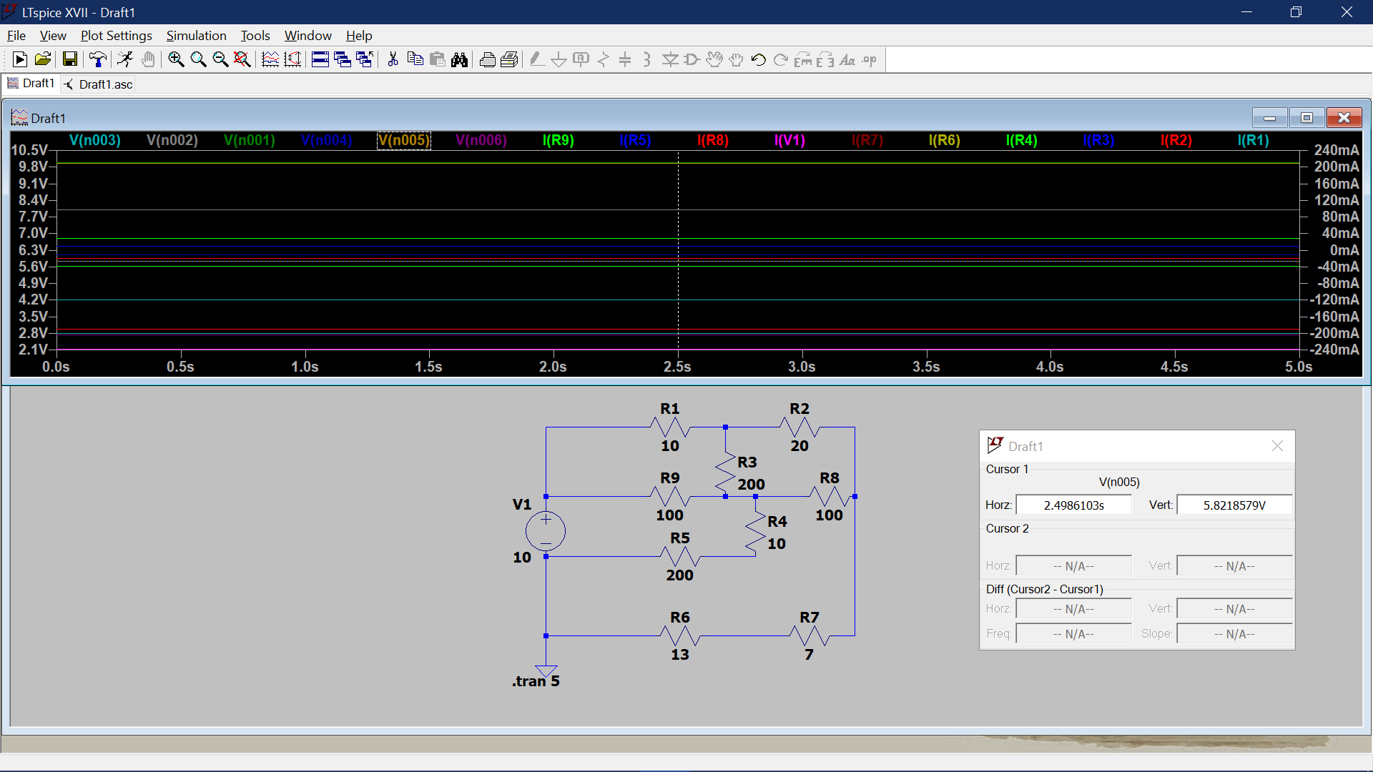
LTSPICE: Output of the circuit

